Slide 1
Fulfilling our promise: A case for systemic global education plan for MPS
Angela Osuji
Minneapolis Public Schools
TGC Fellow 2014
Notes:
Presentation to the TGC Cohort

Slide 2
Global Education is culturally relevant education for the 21st century global citizen

Slide 3
MPS Students
Notes:
Symbolism . Let’s examine what this means for them and try to put ourselves in their shoes. How do we help them maximize their potential and package their brand to enable them to compete globally, effectively and efficiently. How do we provide them learning opportunities that are relevant to their prevailing culture?

Slide 4
Mps motto
Urban Education, Global Citizen
Notes:
To what extent are we ensuring that our global citizens are receiving culturally relevant education – the 21st and beyond culture? What if Urban education is synonymous with Global Education? Global Education is culturally relevant education for our global citizens.

Slide 5
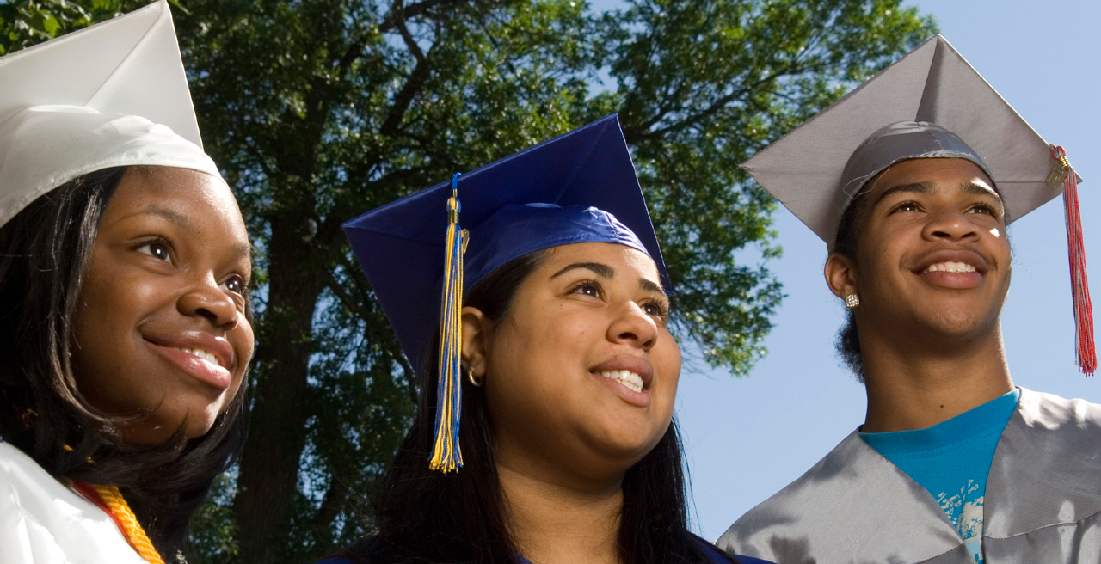
MPS Vision
Every child college and career ready
Notes:
We seek to educate our students to

Slide 6
MPS Promise
Minneapolis Public Schools promises an inspirational education experience in a safe, welcoming environment for all diverse learners to acquire the tools and skills necessary to confidently engage in the global community.
Notes:
As part of our Acceleration 2020 Strategic plan, it is now imperative that we begin to fulfill our promise to our students, families and community by enacting a focus systemic action plan for global education. Our citizen deserve nothing less.

Slide 7
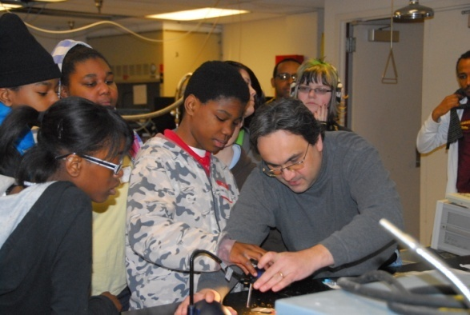
Our community
Is Global
Needs to Educate the Community’s citizen
Global Education becomes Imperative.
Global Competence is essential for effective citizenship

Slide 8
The Buzz
21st Century skills
Education of and for the Whole child
STEM
STEAM
Cultural Competency
Equity
Communication
Language Acquisition and Development
Higher Order Critical Thinking
Sustainability
Race to the Top
Notes:
We are already addressing these ‘buzz’ around us.

Slide 9
21st Century skills-VIDEO CLIPS
https://www.youtube.com/watch?v=Ax5cNlutAys/
http://sites.sandiego.edu/globaleducation/defining-global-education/.
https://www.youtube.com/watch?v=l72UFXqa8ZU&feature=related
What is 21st Century Education
Notes:
Our world is changing at an unprecedented pace. To prepare our students, lessons must go beyond the "3 R's" and foster 21st century skills. Skills like critical thinking, communication, collaboration and creativity will be essential for students to take on the challenges and opportunities that lie ahead.

Slide 10
What is global competence?
Global competence is the capacity and disposition to understand and act on issues of global significance.
Globally competent individuals
are aware, curious, and interested in learning about the world and how it works.
can use the big ideas, tools, methods, and languages that are central to any discipline (mathematics, literature, history, science, and the arts) to engage the pressing issues of our time.
deploy and develop this expertise as they investigate such issues, recognizing multiple perspectives, communicating their views effectively,
take action to improve conditions.

Slide 11
Dimensions of global competence:
Investigate the world beyond their immediate environment, framing significant problems and conducting well-crafted and age-appropriate research.
Recognize perspectives, others’ and their own, articulating and explaining such perspectives thoughtfully and respectfully.
Communicate ideas effectively with diverse audiences, bridging geographic, linguistic, ideological, and cultural barriers.
Take action to improve conditions, viewing themselves as players in the world and participating reflectively.

Slide 12
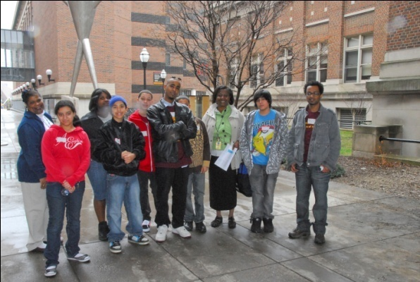
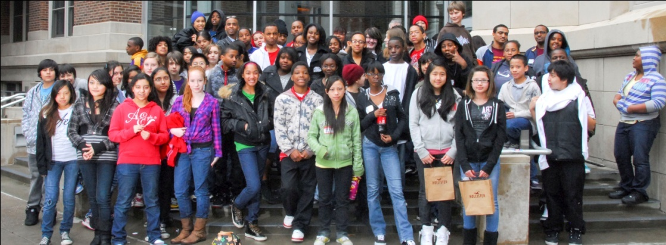
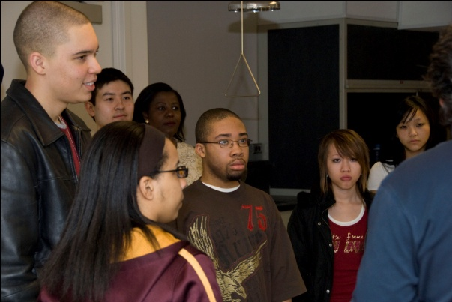
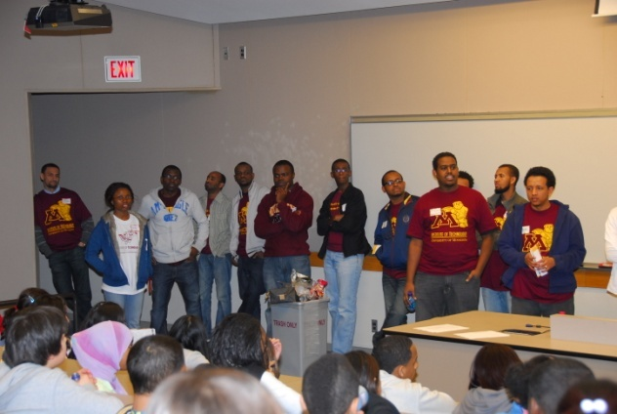
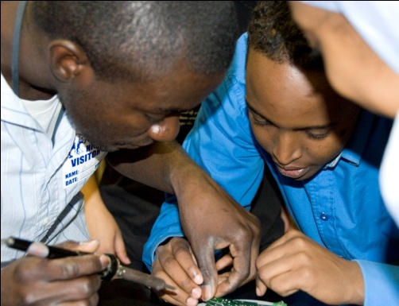
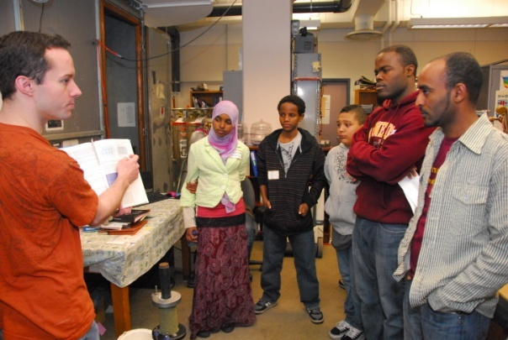
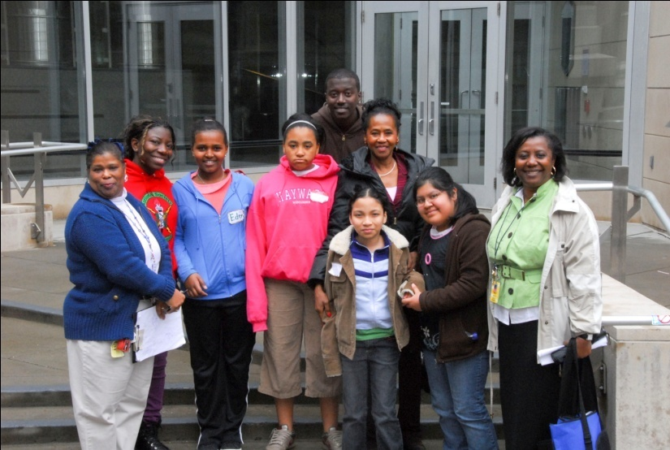
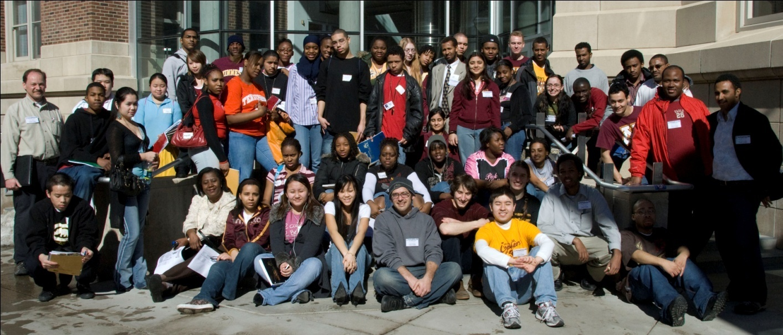
GLOBALLY COMPETENT CITIZENS
Notes:
12
Investigate the World, recognize perspectives, others’ and their own, communicate ideas effectively with diverse audiences and take action to improve conditions.

Slide 13
ARE WE THERE YET: Examining data
Are we on track ?
What evidence do we have?
Focus on Demographic Data
What will be our next steps?

Slide 14
Middle School A College Readiness (Explore Test)

Slide 15
High School A College Readiness (Plan Test)
Notes:
MPS 20

Slide 16
A Case for global Education
Notes:
http://www.pinterest.com/pin/546483736006046219/

Slide 17
Effective schools
are culturally responsive to racial, ethnic, and cultural groups, when they incorporate equity concerns as framework for understanding and inquiry (Banks et al.2007)

Slide 18
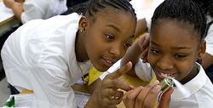
Why is Global education important?
Global education is so important because global mass extinctions and life-support services are seriously stressed. To solve these “wickedly” complex problems we need to work collaboratively to solve them.
Understanding and connection with others promote peace. - A Global Education Declaration by Amy Brinkley on Global Education Conference, 2013
Notes:
Excerpts from the NSTA Pathways to the Science Standards (1997-1998); in each edition see Appendix B: National Science Education Standards

Slide 19
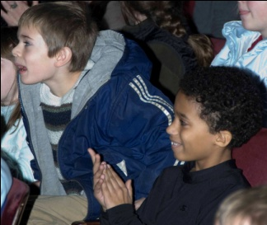
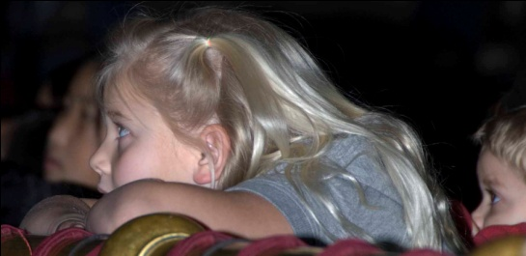
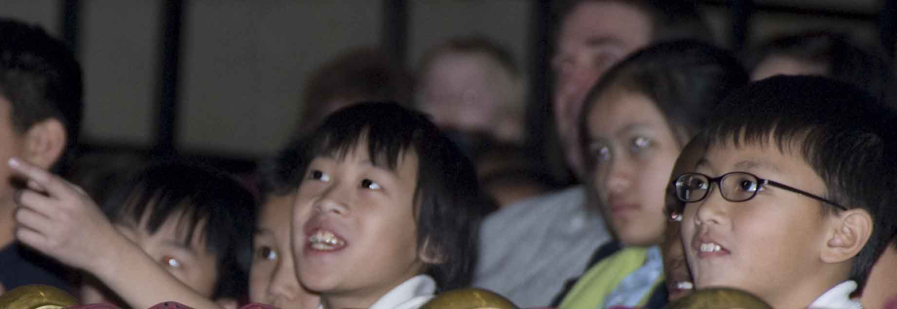
IMPLICATIONS FOR SCHOOLS?
Promote Inquiry
Be Culturally Competent – awareness, knowledge and Skill
Foster Connections across cultures
Build stakeholder capacity
Notes:
19

Slide 20
Resources
Asia Society: http://asiasociety.org/files/book-globalcompetence.pdf
Primary Source: http://www.primarysource.org/
Edsteps: http://www.edsteps.org/CCSSO/Home.aspx
Teacher for Global Classrooms Program: http://www.irex.org/project/teachers-global-classrooms-program-tgc.
Innovation Earth: http://innovationonearth.com/tech/
UNESCO: https://en.unesco.org/themes/education-21st-century/
Global Education Conference: http://www.globaleducationconference.com/page/2014-conference/

